Slide 1
Database Recovery Techniques
Dr. Manjiree Vyawahare

Slide 2
Databases Recovery
1. Purpose of Database Recovery
2. Types of Failure
3 . Transaction Log
4 . Data Updates
5. Data Caching
6 . Transaction Roll-back (Undo) and Roll-Forward
7 . Check pointing A [checkpoint, list of active transactions]
8 . Recovery schemes
9 . ARIES Recovery Scheme
10. Recovery in Multi database System

Slide 3
Database Recovery
1 Purpose of Database Recovery
To bring the database into the last consistent state, which existed prior to the failure.
To preserve transaction properties (Atomicity, Consistency, Isolation and Durability).
Example:
If the system crashes before a fund transfer transaction completes its execution, then either one or both accounts may have incorrect value. Thus, the database must be restored to the state before the transaction modified any of the accounts.

Slide 4
Database Recovery
2 Types of Failure
The database may become unavailable for use due to
Transaction failure: Transactions may fail because of incorrect input, deadlock, incorrect synchronization.
System failure: System may fail because of addressing error, application error, operating system fault, RAM failure, etc.
Media failure: Disk head crash, power disruption, etc.

Slide 5
Database Recovery
3 Transaction Log
For recovery from any type of failure data values prior to modification (BFIM - BeFore Image) and the new value after modification (AFIM – AFter Image) are required.
These values and other information is stored in a sequential file called Transaction log. A sample log is given below. Back P and Next P point to the previous and next log records of the same transaction.

Slide 6
Database Recovery
4 Data Update
Immediate Update: As soon as a data item is modified in cache, the disk copy is updated.
Deferred Update: All modified data items in the cache is written either after a transaction ends its execution or after a fixed number of transactions have completed their execution.
Shadow update: The modified version of a data item does not overwrite its disk copy but is written at a separate disk location.
In-place update: The disk version of the data item is overwritten by the cache version.

Slide 7
Database Recovery
5 Data Caching
Data items to be modified are first stored into database cache by the Cache Manager (CM) and after modification they are flushed (written) to the disk.
The flushing is controlled by Modified and Pin-Unpin bits.
Pin-Unpin: Instructs the operating system not to flush the data item.
Modified: Indicates the AFIM of the data item.

Slide 8
Database Recovery
6 Transaction Roll-back (Undo) and Roll-Forward (Redo)
To maintain atomicity, a transaction’s operations are redone or undone.
Undo: Restore all BFIMs on to disk (Remove all AFIMs).
Redo: Restore all AFIMs on to disk.
Database recovery is achieved either by performing only Undos or only Redos or by a combination of the two. These operations are recorded in the log as they happen.
[ BFIM - BeFore Image)
(AFIM – AFter Image) ]

Slide 9
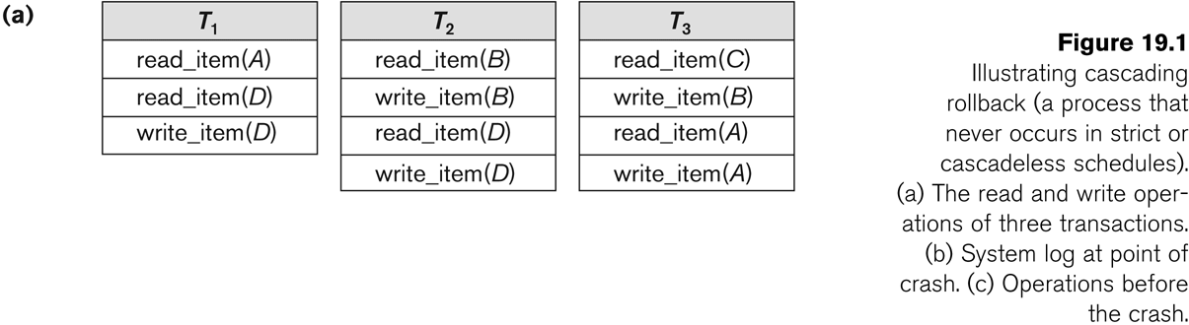
Database Recovery

Slide 10
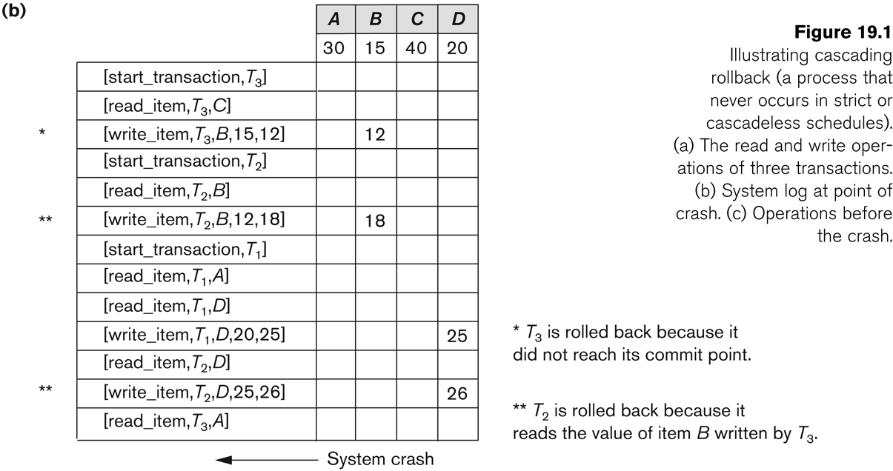
Database Recovery

Slide 11
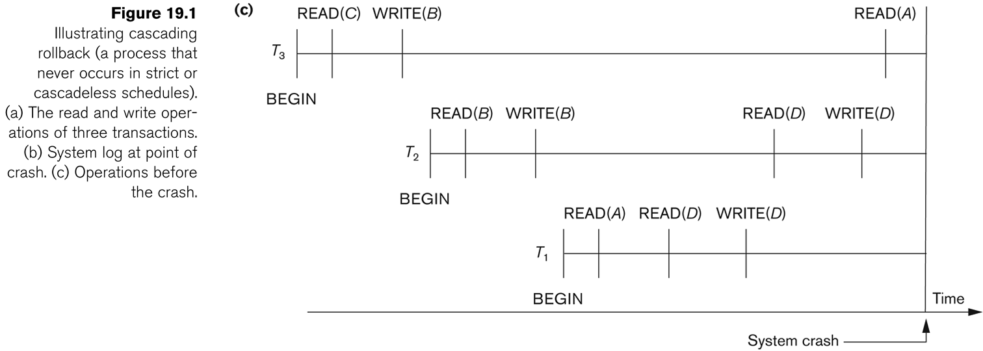
Database Recovery
Roll-back: One execution of T1, T2 and T3 as recorded in the log.

Slide 12
Database Recovery
Write-Ahead Logging
When in-place update (immediate or deferred) is used then log is necessary for recovery and it must be available to recovery manager. This is achieved by Write-Ahead Logging (WAL) protocol. WAL states that
For Undo: Before a data item’s AFIM is flushed to the database disk (overwriting the BFIM) its BFIM must be written to the log and the log must be saved on a stable store (log disk).
For Redo: Before a transaction executes its commit operation, all its AFIMs must be written to the log and the log must be saved on a stable store.

Slide 13
Database Recovery
7 Checkpointing
Time to time (randomly or under some criteria) the database flushes its buffer to database disk to minimize the task of recovery. The following steps defines a checkpoint operation:
Suspend execution of transactions temporarily.
Force write modified buffer data to disk.
Write a [checkpoint] record to the log, save the log to disk.
Resume normal transaction execution.
During recovery redo or undo is required to transactions appearing after [checkpoint] record.

Slide 14
fuzzy checkpointing
The time needed to force-write all modified memory buffers may delay transaction processing because of step 1. To reduce this delay, it is common to use a technique called fuzzy checkpointing.
In this technique, the system can resume transaction processing after a [begin_checkpoint] record is written to the log without having to wait for step 2 to finish.
When step 2 is completed, an [end_checkpoint, ...] record is written in the log with the relevant information collected during checkpointing.
However, until step 2 is completed, the previous checkpoint record should remain valid.
To accomplish this, the system maintains a file on disk that contains a pointer to the valid checkpoint, which continues to point to the previous checkpoint record in the log.
Once step 2 is concluded, that pointer is changed to point to the new checkpoint in the log.

Slide 15
Database Recovery
Steal/No-Steal and Force/No-Force
Possible ways for flushing database cache to database disk:
Steal: Cache can be flushed before transaction commits.
No-Steal: Cache cannot be flushed before transaction commit.
Force: Cache is immediately flushed (forced) to disk.
No-Force: Cache is deferred until transaction commits
These give rise to four different ways for handling recovery:
Steal/No-Force (Undo/Redo)
Steal/Force (Undo/No-redo)
No-Steal/No-Force (Redo/No-undo)
No-Steal/Force (No-undo/No-redo)

Slide 16
Database Recovery
8 Recovery Scheme
Deferred Update (No Undo/Redo)
The data update goes as follows:
A set of transactions records their updates in the log.
At commit point under WAL scheme these updates are saved on database disk.
After reboot from a failure the log is used to redo all the transactions affected by this failure. No undo is required because no AFIM is flushed to the disk before a transaction commits.

Slide 17
Database Recovery
Deferred Update in a single-user system There is no concurrent data sharing in a single user system. The data update goes as follows:
A set of transactions records their updates in the log.
At commit point under WAL scheme these updates are saved on database disk.
After reboot from a failure the log is used to redo all the transactions affected by this failure. No undo is required because no AFIM is flushed to the disk before a transaction commits.

Slide 18
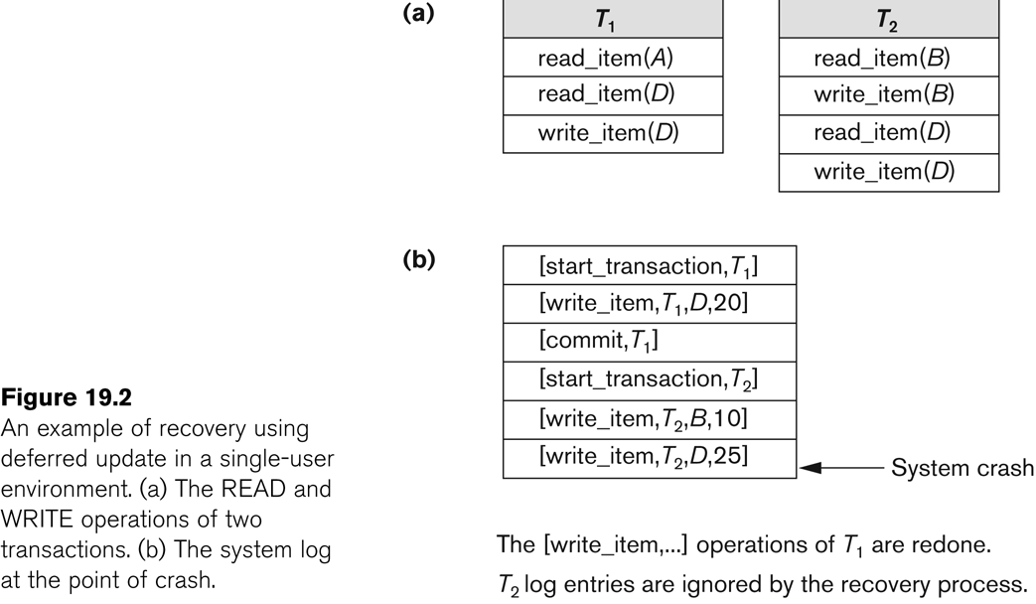
Database Recovery

Slide 19
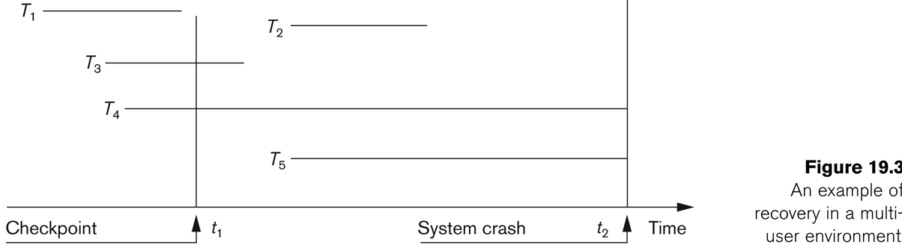
Database Recovery
Deferred Update with concurrent users
This environment requires some concurrency control mechanism to guarantee isolation property of transactions. In a system recovery transactions which were recorded in the log after the last checkpoint were redone. The recovery manager may scan some of the transactions recorded before the checkpoint to get the AFIMs.

Slide 20
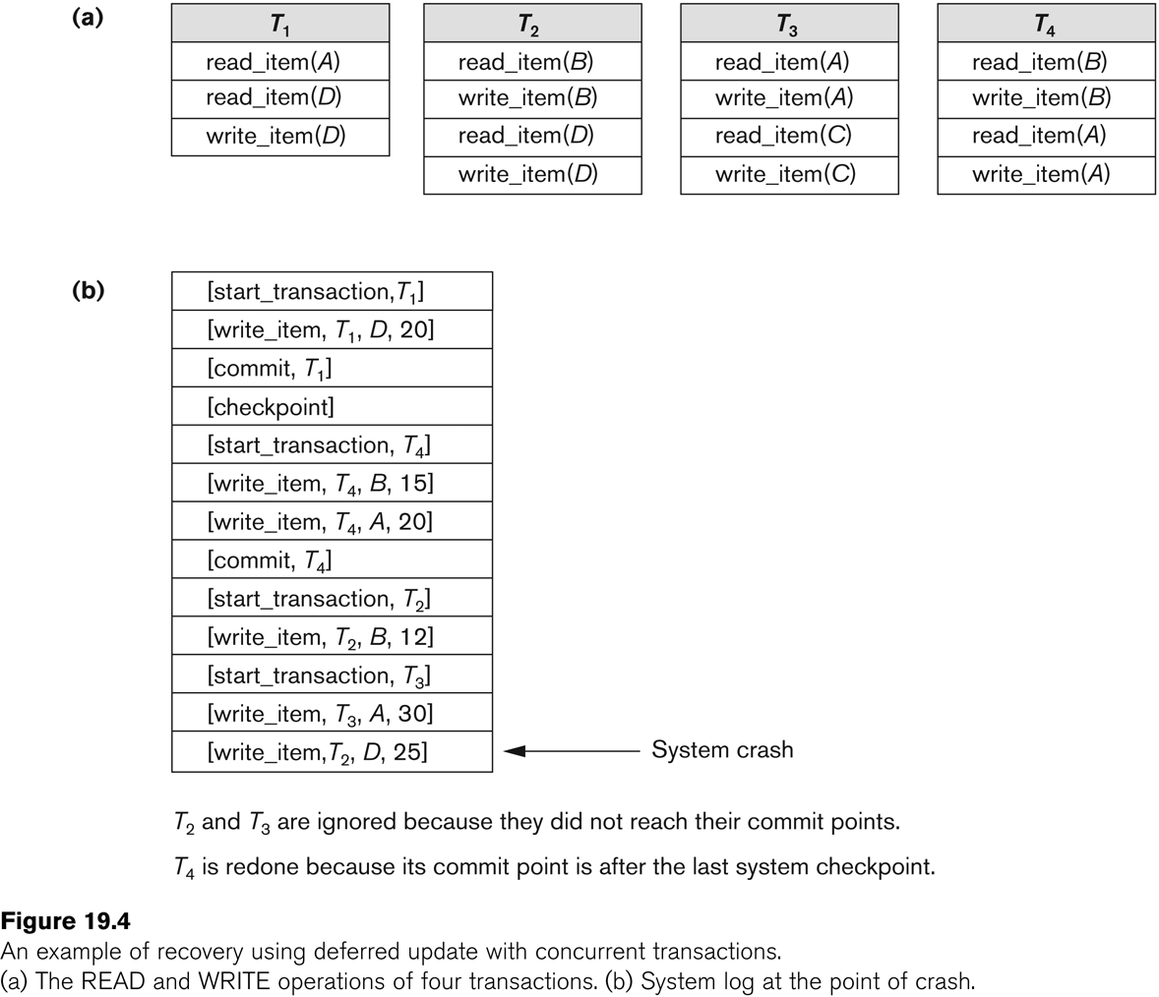
Database Recovery

Slide 21
Database Recovery
Deferred Update with concurrent users
Two tables are required for implementing this protocol:
Active table: All active transactions are entered in this table.
Commit table: Transactions to be committed are entered in this table.
During recovery, all transactions of the commit table are redone and all transactions of active tables are ignored since none of their AFIMs reached the database. It is possible that a commit table transaction may be redone twice but this does not create any inconsistency because of a redone is “idempotent”, that is, one redone for an AFIM is equivalent to multiple redone for the same AFIM.

Slide 22
Database Recovery
Recovery Techniques Based on Immediate Update
Undo/No-redo Algorithm
In this algorithm AFIMs of a transaction are flushed to the database disk under WAL before it commits.
For this reason the recovery manager undoes all transactions during recovery.
No transaction is redone.
It is possible that a transaction might have completed execution and ready to commit but this transaction is also undone.

Slide 23
Database Recovery
Recovery Techniques Based on Immediate Update
Undo/Redo Algorithm (Single-user environment)
Recovery schemes of this category apply undo and also redo for recovery.
In a single-user environment no concurrency control is required but a log is maintained under WAL.
Note that at any time there will be one transaction in the system and it will be either in the commit table or in the active table.
The recovery manager performs:
Undo of a transaction if it is in the active table.
Redo of a transaction if it is in the commit table.

Slide 24
Database Recovery
Recovery Techniques Based on Immediate Update
Undo/Redo Algorithm (Concurrent execution)
Recovery schemes of this category applies undo and also redo to recover the database from failure.
In concurrent execution environment a concurrency control is required and log is maintained under WAL.
Commit table records transactions to be committed and active table records active transactions. To minimize the work of the recovery manager checkpointing is used.
The recovery performs:
Undo of a transaction if it is in the active table.
Redo of a transaction if it is in the commit table.

Slide 25
Database Recovery
Shadow Paging
The AFIM does not overwrite its BFIM but recorded at another place on the disk. Thus, at any time a data item has AFIM and BFIM (Shadow copy of the data item) at two different places on the disk.
X and Y: Shadow copies of data items
X' and Y': Current copies of data items

Slide 26
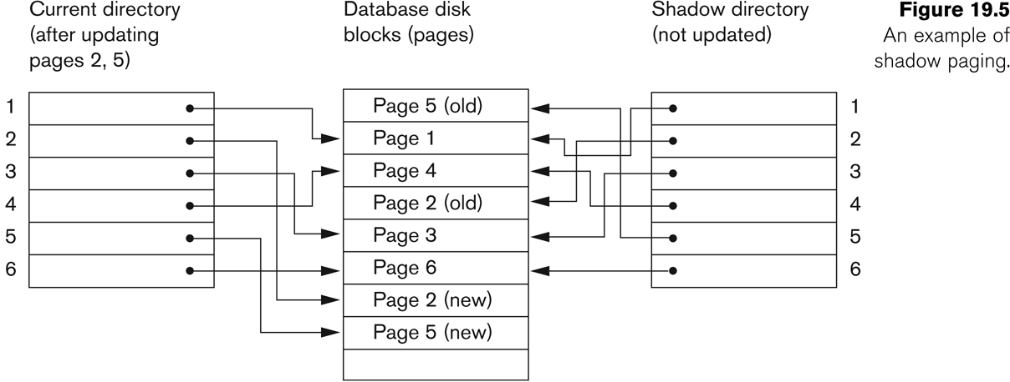
Database Recovery
Shadow Paging
To manage access of data items by concurrent transactions two directories (current and shadow) are used.
The directory arrangement is illustrated below. Here a page is a data item.

Slide 27
Database Recovery
The ARIES Recovery Algorithm
The ARIES Recovery Algorithm is based on:
WAL (Write Ahead Logging)
Repeating history during redo:
ARIES will retrace all actions of the database system prior to the crash to reconstruct the database state when the crash occurred.
Logging changes during undo:
It will prevent ARIES from repeating the completed undo operations if a failure occurs during recovery, which causes a restart of the recovery process.

Slide 28
Database Recovery
The ARIES Recovery Algorithm (contd.)
The ARIES recovery algorithm consists of three steps:
Analysis: step identifies the dirty (updated) pages in the buffer and the set of transactions active at the time of crash. The appropriate point in the log where redo is to start is also determined.
Redo: necessary redo operations are applied.
Undo: log is scanned backwards and the operations of transactions active at the time of crash are undone in reverse order.

Slide 29
Database Recovery
The ARIES Recovery Algorithm (contd.)
The Log and Log Sequence Number (LSN)
A log record is written for:
(a) data update
(b) transaction commit
(c) transaction abort
(d) undo
(e) transaction end
In the case of undo a compensating log record is written.

Slide 30
Database Recovery
The ARIES Recovery Algorithm (contd.)
The Log and Log Sequence Number (LSN) (contd.)
A unique LSN is associated with every log record.
LSN increases monotonically and indicates the disk address of the log record it is associated with.
In addition, each data page stores the LSN of the latest log record corresponding to a change for that page.
A log record stores
(a) the previous LSN of that transaction
(b) the transaction ID
(c) the type of log record.

Slide 31
Database Recovery
The ARIES Recovery Algorithm (contd.)
The Log and Log Sequence Number (LSN) (contd.)
A log record stores:
Previous LSN of that transaction: It links the log record of each transaction. It is like a back pointer points to the previous record of the same transaction
Transaction ID
Type of log record
For a write operation the following additional information is logged:
Page ID for the page that includes the item
Length of the updated item
Its offset from the beginning of the page
BFIM of the item
AFIM of the item

Slide 32
Database Recovery
The ARIES Recovery Algorithm (contd.)
The Transaction table and the Dirty Page table
For efficient recovery following tables are also stored in the log during checkpointing:
Transaction table: Contains an entry for each active transaction, with information such as transaction ID, transaction status and the LSN of the most recent log record for the transaction.
Dirty Page table: Contains an entry for each dirty page in the buffer, which includes the page ID and the LSN corresponding to the earliest update to that page.

Slide 33
Database Recovery
The ARIES Recovery Algorithm (contd.)
Checkpointing
A checkpointing does the following:
Writes a begin_checkpoint record in the log
Writes an end_checkpoint record in the log. With this record the contents of transaction table and dirty page table are appended to the end of the log.
Writes the LSN of the begin_checkpoint record to a special file. This special file is accessed during recovery to locate the last checkpoint information.
To reduce the cost of checkpointing and allow the system to continue to execute transactions, ARIES uses “fuzzy checkpointing”.

Slide 34
Database Recovery
The ARIES Recovery Algorithm (contd.)
The following steps are performed for recovery
Analysis phase: Start at the begin_checkpoint record and proceed to the end_checkpoint record. Access transaction table and dirty page table are appended to the end of the log. Note that during this phase some other log records may be written to the log and transaction table may be modified. The analysis phase compiles the set of redo and undo to be performed and ends.
Redo phase: Starts from the point in the log up to where all dirty pages have been flushed, and move forward to the end of the log. Any change that appears in the dirty page table is redone.
Undo phase: Starts from the end of the log and proceeds backward while performing appropriate undo. For each undo it writes a compensating record in the log.
The recovery completes at the end of undo phase.

Slide 35
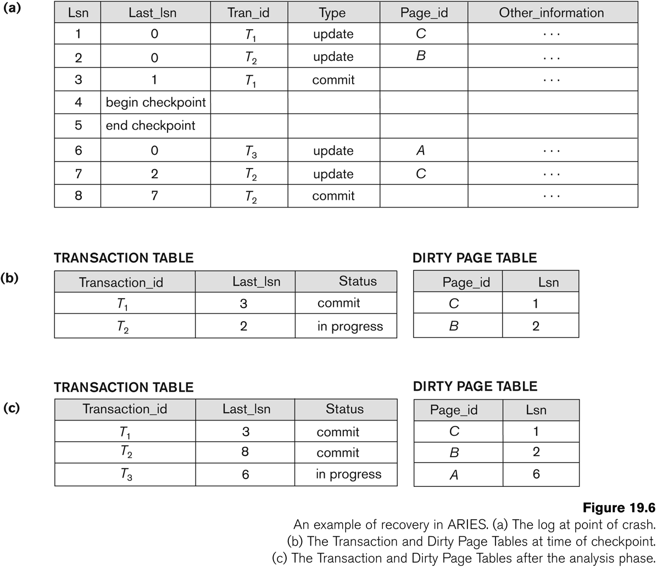
Database Recovery

Slide 36
Database Recovery
10 Recovery in multidatabase system
A multidatabase system is a special distributed database system where one node may be running relational database system under UNIX, another may be running object-oriented system under Windows and so on.
A transaction may run in a distributed fashion at multiple nodes.
In this execution scenario the transaction commits only when all these multiple nodes agree to commit individually the part of the transaction they were executing.
This commit scheme is referred to as “two-phase commit” (2PC).
If any one of these nodes fails or cannot commit the part of the transaction, then the transaction is aborted.
Each node recovers the transaction under its own recovery protocol.

Slide 37
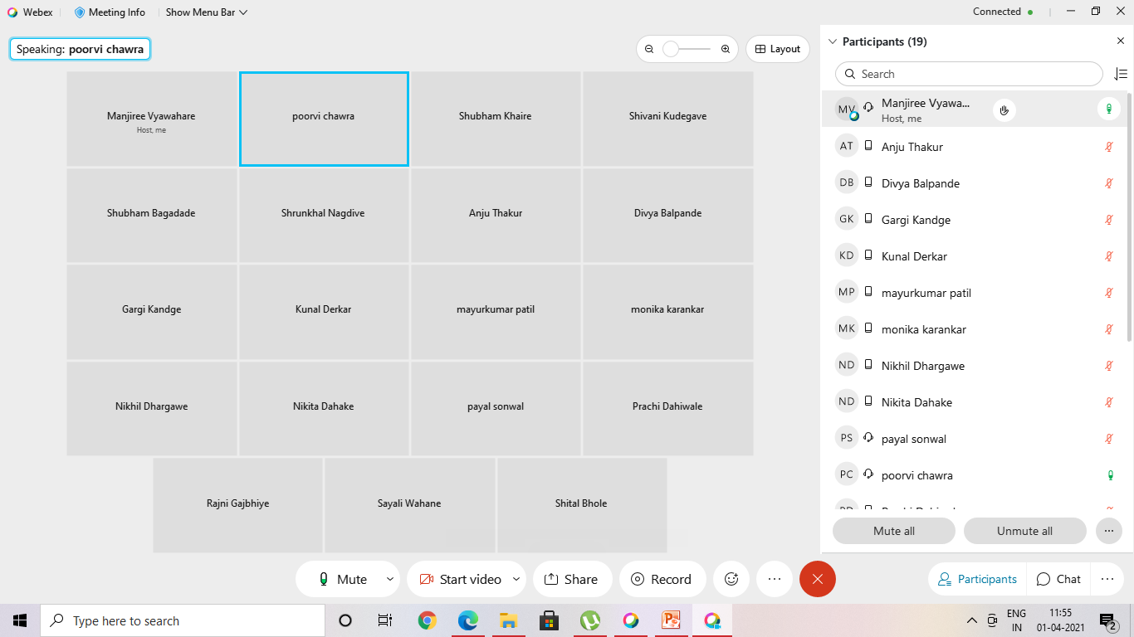
1-april -21 two Lect

Slide 38
Summary
Databases Recovery
Types of Failure
Transaction Log
Data Updates
Data Caching
Transaction Roll-back (Undo) and Roll-Forward
Checkpointing
Recovery schemes
ARIES Recovery Scheme
Recovery in Multidatabase System

Slide 39
23.5 (821pgno) ARIES algorithm
We now describe the ARIES algorithm as an example of a recovery algorithm used in database systems.
It is used in many relational database-related products of IBM. ARIES uses a steal/no-force approach for writing, and it is based on three concepts: write-ahead logging, repeating history during redo, and logging changes during undo.
We discussed write-ahead logging in Section 23.1.3. The second concept, repeating history, means that ARIES will retrace all actions of the database system prior to the crash to reconstruct the database state when the crash occurred.
Transactions that were uncommitted at the time of the crash (active transactions) are undone. The third concept, logging during undo, will prevent ARIES from repeating the completed undo operations if a failure occurs during recovery, which causes a restart of the recovery process.
The ARIES recovery procedure consists of three main steps: analysis, REDO, and UNDO. The analysis step identifies the dirty (updated) pages in the buffer6 and the set of transactions active at the time of the crash. The appropriate point in the log where the REDO operation should start is also determined. The REDO phase actually reapplies updates from the log to the database. Generally, the REDO operation is applied only to committed transactions. However, this is not the case in ARIES. Certain information in the ARIES log will provide the start point for REDO, from 6The actual buffers may be lost during a crash, since they are in main memory. Additional tables stored in the log during checkpointing (Dirty Page Table, Transaction Table) allows ARIES to i

Slide 40
cascading rollback,
If a transaction T is rolled back, any transaction S that has, in the interim, read the value of some data item X written by T must also be rolled back. Similarly, once S is rolled back, any transaction R that has read the value of some data item Y written by S must also be rolled back; and so on. This phenomenon is called cascading rollback, and can occur when the recovery protocol ensures recoverable schedules but does not ensure strict or cascadeless schedules (see Section 21.4.2). Understandably, cascading rollback can be quite complex and time-consuming. That is why almost all recovery mechanisms are designed so that cascading rollback is never required.

